Slide 1
ACTUAL INTERPRETATIONS IN THE HISTORY AND SOCIOLOGY OF SCIENCE
by
Pal Tamas
using teaching materials of
A.Jamison, R.DiSalle, A.Genua,

Slide 2
Transfer/ Pasteur Quadrant sciences

Slide 3
Transfer Sciences
‘Transfer sciences’ are those where
  researchers able to develop research programme around economic concerns without compromising their reputation
  industrial researchers able to contribute to disciplinary goals without compromising their job (secrecy)
  See also Donald E. Stokes Pasteur Quadrant (http://en.wikipedia.org/wiki/Pasteur%27s_Quadrant)
‘Life cycle’ of a technology/science may influence way in which the goals are perceived by U researchers and thus the implications for professional reputation of those who work towards externally set goals

Slide 4
Donald E. Stokes Pasteur Quadrant
 |  | Considerations of use?
 |  | ✗ | ✓
Quest for fundamental understanding? | ✓
 | ✗
Pure basic
research
Use-inspired
basic research
Pure applied
research
Source: Donald E. Stokes, Pasteur’s Quadrant, p. 73

Slide 5
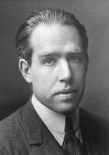
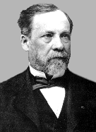
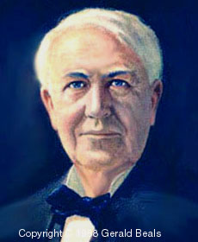
Donald E. Stokes Pasteur Quadrant
 |  | Considerations of use?
 |  | ✗ | ✓
Quest for fundamental understanding? | ✓
 | ✗
Niels
Bohr
Louis
Pasteur
Thomas
Edison
Source: Donald E. Stokes, Pasteur’s Quadrant, p. 73

Slide 6
Nano, bio, info sciences
What do they have in common?
  Cognitively the science generated is not clearly distinguishable from the technology related to it
  Function like conventional disciplines/specialisms – have own resources and evaluation criteria, and capacity to provide for reputation and career
  By virtue of membership of non-academic producers, users and regulators, they provide social structures within which technological innovations are developed

Slide 7
University-industrial Relations -Historical Trends
< 1945
  See the development of the chemical industry in Germany 1860-1880 (for example G. M. Thurow, 1982 or The British Journal for the History of Science, Vol. 25, No. 1, Organic Chemistry and High Technology, 1850-1950, Mar., 1992 );
  Land grant colleges or MIT in the US

Slide 8
Historical trends
1945/55-1980s
  industry relied on universities mainly for supply of QSEs (e.g. for own R&D labs) – exercised some influence on curricula in e.g. engineering, chemistry;
  knowledge often flowed first through public sector labs before taken up by industrial labs;
  Industrial funding continue to play a role, see the interaction between big private labs -e.g. Bell Labs- and university professors, but shadowed by large increase in public funding (Sputnik / Cold War);

Slide 9
Historical trends
1945/55-1980s
  industrial support for universities often took form of endowments and gifts (rather than specific
  project contracts) i.e. no ‘strings’ attached;
  responsibility of university was to publish results
  of research so that available to all;

Slide 10
Historical trends (1980s onward)
US
  NSF established University-Industry Cooperative Research Centers (UICRCs) 1975.
    e.g. Center for Integrated Systems (Stanford)
  Required changes to regulations on cartels to allow establishment of industrial consortia
  NSF subsequently launched Engineering Research Centers, and Science and Technology Centers
  Later, individual firms signed multi-M$ partnership deals with academic departments (e.g. Monsanto & Washington U, Hoechst and Harvard Med School) ➔ concerns re (foreign) firms ‘buying up’ U departments

Slide 11
Historical trends (continued)
UK
  establishment of Alvey Programme in early ’80s to foster collaboration between I and U in IT
  followed by variety of other schemes to foster U-I collaboration
Other OECD countries.
Industry still only accounts for around 6% of university research funding (in most countries)

Slide 12
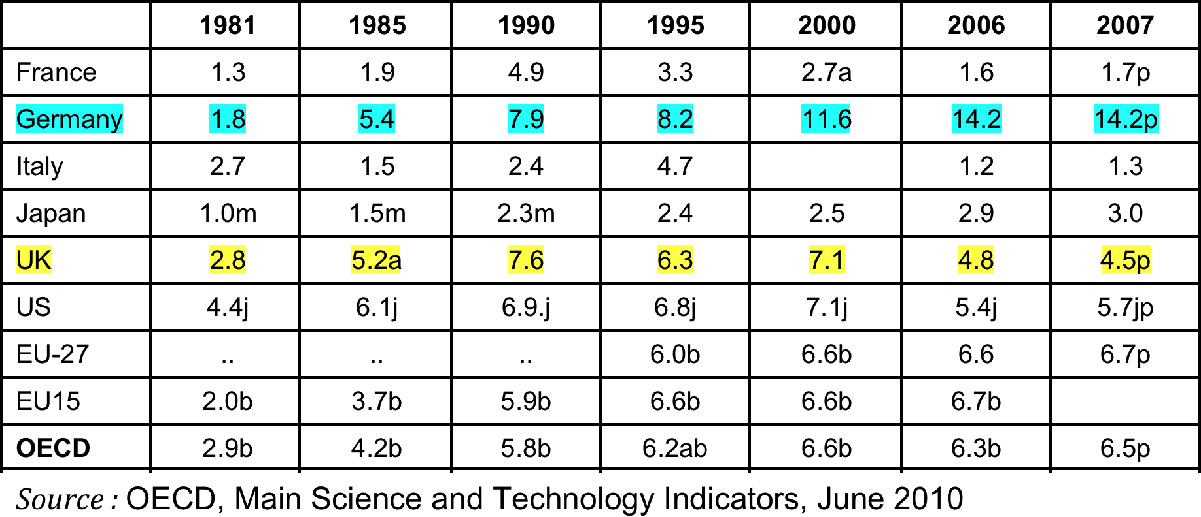
% of HERD financed by industry

Slide 13
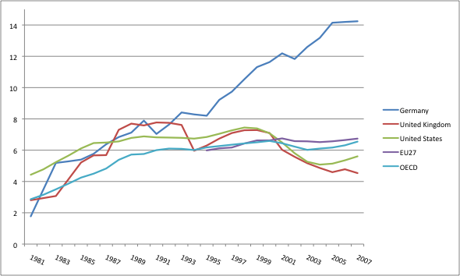
Share HERD financed by Business

Slide 14
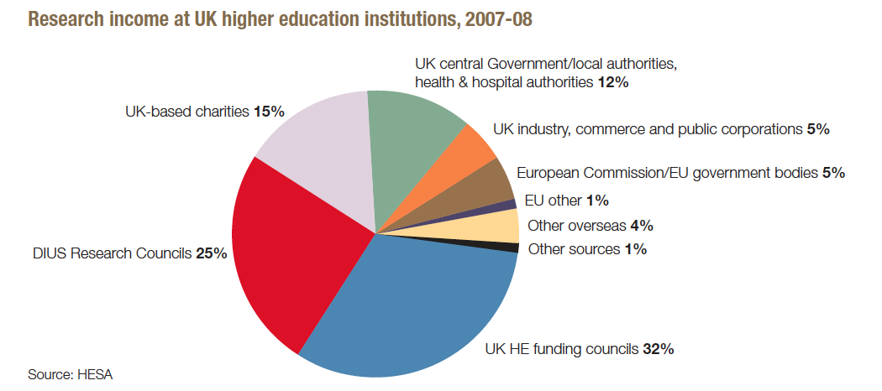
Research Income

Slide 15
Governance systems

Slide 16
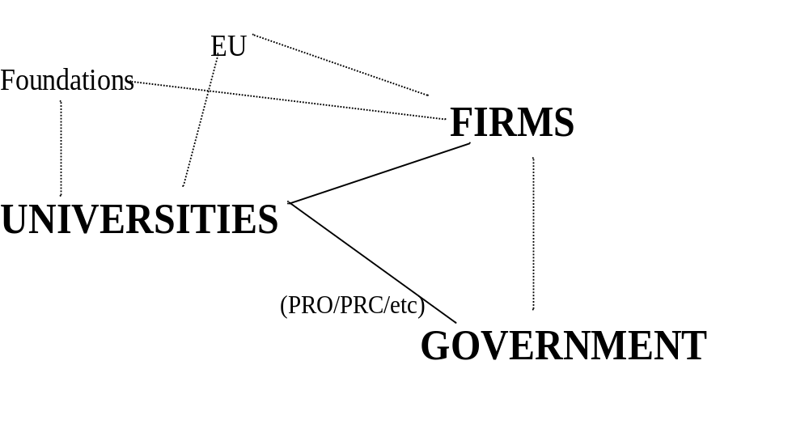
University-Industry Relationships
Publications
Patents
Contracts
Corporate teaching
Secondment
Services
……
…..

Slide 17
Governance systems
There are two different governance systems of the interactions between academic and industrial scientists (Geuna and Muscio, 2009)
  1. those that take place via direct contacts between the academic scientists and the company: personal contractual collaborations
  2. those mediated by universities for example through their technology transfer offices or knowledge transfer organisations: institutional collaborations

Slide 18
Governance of KT
Models of governance of KN:
  The traditional “personal contractual collaborations” model:
    Individual scientist;
    Company R&D lab;
    Advisers / problem solvers informal (though paid) trust related relationships;
    Secondment to large labs (see the Bell Labs history);
    High level of professor independence;
    Budgetary expansion.

Slide 19
Governance of KT
2. Institutionalisation of KT:
  Creation (or development were they existed previously as liaison offices) of Knowledge Transfer Organisations (KTOs) within the uni responsible for the management of KT activities;
  Downsizing of company labs and small companies R&D;
  Service and research contracts;
  New roles for the uni (economic development);
  Professors considered more as employees;
  Budgetary constrains.

Slide 20
Changing Relations Between Science and Society
risk society and uncertain knowledge (Beck)
post-normal science (Ravetz)
a new mode of knowledge production (Gibbons et al)
from science to research: constructivism (Latour)

Slide 21
The Risk Society Thesis (Beck)
a variant of post-industrialism
outgrowth of nuclear energy and biotech debates
from production of ”goods” to ”bads”
the ”manufacturing of uncertainties”
need for ”reflexivity” about the limits of science

Slide 22
Post-normal science (Ravetz)
Science and politics distinction no longer valid
Related to change from government to governance
Rise of new fields of management (e.g. EM)
An inherent complexity in understanding risks
A need for a policy-oriented risk assessment

Slide 23
Changing Modes of
Knowledge Production
Mode 1 Mode 1½ Mode 2
“Little Science” “Big Science” “Technoscience”
Before WWII 1940s-1970s 1980s-
Type of
Knowledge disciplinary multidisciplinary transdisciplinary
Organiza- individuals or R&D departments ad hoc projects and
tional form research groups and institutes networks
Dominant
values academic bureaucratic entrepreneurial

Slide 24
The Norms of Science (Merton)
a sociology of ”little science”
a defense of science from communism and nazism
”institutional imperatives” of science
related to liberal political philosophy
CUDOS: commun(al)ity, universalism, distinterestedness, organized skepticism

Slide 25
From Little Science to Big Science
result of use of science in WW2
change in size and scale
mission orientation, external control
university-government collaboration
bureaucratic norm, or value system
new role for the state: ”science policy”

Slide 26
Critiques of Big Science in the 1960s
moral, or spiritual (e.g. Martin Luther King)
  against injustice,”poverty of the spirit”
  for a new morality, or sense of justice
ecological, or internal (e.g. Rachel Carson)
  against reductionism, ”the abuse of the planet”
  for a new, environmental science
humanist, or cultural (e.g. Lewis Mumford)
  against hubris, ”the myth of the machine”
  for an appropriate technology

Slide 27
From Big Science to Technoscience
change in range and scope
market orientation, corporate control
university-industry collaboration
entrepreneurial norm, or value system
the state as strategist: innovation policy
from assessment to promotion: ”foresight”

Slide 28
The Age of Technoscience
blurring discursive boundaries
  between science (episteme) and technology (techne)
breaking down institutional borders
  between public and private, economic and academic
mixing skills and knowledge
  across faculties, disciplines, and societal domains

Slide 29
Contending Cognitive Strategies
The dominant , or hegemonic strategy (mode 2):
commercialization, entrepreneurship, transdisciplinarity
The residual, or traditionalist strategy (mode 1):
  academicization, expertise, (sub)disciplinarity
An emerging, or sustainable strategy (mode 3):
  appropriation, empowerment, interdisciplinarity

Slide 30
Transdisciplinarity, or Mode 2
”Knowledge which emerges from a particular context of application with its own distinct theoretical structures, research methods and modes of practice but which may not be locatable on the prevailing disciplinary map.”
Michael Gibbons et al, The New Production of Knowledge (Sage 1994, p168)

Slide 31
Contextual Differences
Mode 1 Mode 2
forms of structural specific
funding (sub)national (trans)national
main university clusters of excellence
work sites departments project networks
framing disciplinary particular contexts
device paradigms of application

Slide 32
Cognitive Differences
Mode 1 Mode 2
cumulative discontinuous
unified pluralist
cooperative competitive
objective constructive
universal situated

Slide 33
The Tendency to Hubris
transgressing established forms of quality control
  ”a drift of epistemic criteria” (Elzinga)
transcending human limitations
  ”converging technologies” (bio, info, cogno, nano)
neglecting public participation and assessment
  lack of accountability and precaution
overemphasis on entrepreneurship
  propagation of competition rather than cooperation

Slide 34
The Forces of Habit(us)
Technoscience primarily seen as providing new opportunities for scientists and engineers
Taught by restructuring established scientific and engineering fields: multi- or ”subdisciplinarity”
Politics and the rest of society left largely outside of research and education: ”outsourcing” of ethics
A continuing belief in separating experts and their knowledge from contexts of use

Slide 35
The Discipline as Habit(us)
“A discipline is defined by possession of a collective capital of specialized methods and concepts, mastery of which is the tacit or implicit price of entry to the field. It produces a ‘historical transcendental,’ the disciplinary habitus, a system of schemes of perception and appreciation (where the incorporated discipline acts as a censorship).”
Pierre Bourdieu, Science of Science and Reflexivity (2004)

Slide 36
The Need for a ”Mode 3”,
or a Hybrid Imagination
At the discursive level
  making connections, combining ideas
At the institutional level
  creating meeting places, building bridges
At the practical/personal level
  fostering hybrid competencies and identities

Slide 37
Inter- or transdisciplinarity?
Interdisciplinarity Transdisciplinarity
integration of disciplines transcendence of disciplines
(internal) problem-driven (external) project-driven
”bottom-up”, self-organized ”top-down”, formalized
a communicative rationality an instrumental rationality

Slide 38
Types of Interdisciplinarity
Collaboration
  synthetic integration
  a sharing of experience and identity
Cooperation
  project-based teamwork
  a process of collective learning

Slide 39
Types of Transdisciplinarity
Nondisciplinarity, or niche-seeking
  a conceptual competence
  theory, or technique-based identity
Subdisciplinarity, or specialization
  a methodological competence
  topic, or area-based identity

Slide 40
For example: STS
Science, Technology and Society
  interdisciplinary education and research
  bridging the ”two cultures” gap
Science and Technology Studies
  transdisciplinary and heterogeneous field
  related to growth of EU research programs

Slide 41
Science, Technology and Society
Collaboration
  finalization, science dynamics
  technology assessment, science shops
Cooperation
  European Association for the Study of Science and Technology (EASST)
  educational exchanges and PhD networks

Slide 42
Science and Technology Studies
Nondisciplinarity, or niche-seeking
  social construction of technology (SCOT)
  actor-network theory, technology foresight
Subdisciplinarity, or sectorial specialization
  science and technology policy
  innovation studies, knowledge management

Slide 43
TURNS IN SCIENCE PROGRAMS
LAKATOS Imre
KUHN Thomas

Slide 44
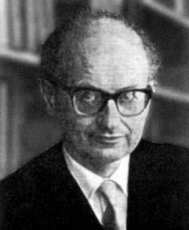
“The Methodology of Scientific Research Programmes” (Imre Lakatos. 1922-1974)
How do scientists decide whether, or when, their theory is refuted?
How do we explain why scientists persist in working on theories in the face of counter-examples?

Slide 45
Lakatos: Scientific theories are not really falsifiable. They are “research programmes” that consist of:
a “hard core” of fundamental principles that contain what the theory really says about the world, and
a “protective belt” of “auxiliary hypotheses” that explain how the fundamental principles apply to particular cases, and how
to deal with apparent discrepancies. These include “ceteris paribus” (“other things being equal”) clauses that accommodate
problematic cases.
Contrary to Popper, even good theories have “defense-mechanisms.”

Slide 46
Lakatos: The fundamental difference is between progressive and degenerating research programmes.
Progressive research programmes lead to novel predictions, new problems, and new solutions.
Degenerating programmes spend their time trying to adjust after the fact to new information, and to protect themselves from refutation by constant adjustment.
The “pseudo-sciences” are really degenerating programmes whose practitioners are mainly devoted to defending the programme against contrary evidence. The progressive programmes view contrary evidence as a challenge that will broaden and deepen the theory.

Slide 47
Thomas Kuhn on Scientific Revolutions
(cf. The Structure of Scientific Revolutions, 1962.)
Paradigm: Kuhn’s idea that a scientific theory is not just a set of theoretical principles. It is an entire world-view, consisting of:
--“Metaphysical” views about the nature of the world and the things in it;
--methodological rules about correct scientific practice;
--a conception of what constitutes a legitimate scientific question and what doesn’t
--a conception of what constitutes a scientific fact;
--“paradigm exemplars” of the right kind of problem to solve and the right way to solve it.

Slide 48
A paradigm, therefore, determines not only a set of beliefs about the world.
It also defines what counts as good science, and even determines what counts as a scientific fact.
It is a conceptual framework that determines how the world looks to those who have accepted it.
It defines not only the scientific outlook for practitioners of a particular science, but also the scientific “form of life.”

Slide 49
There are two aspects to the history of any science:
Normal science: science pursued within the constraints of a particular paradigm, without questioning its principles. The characteristic activity is “puzzle solving,” i.e. answering questions set by the paradigm using the methods sanctioned by it.
Revolutionary science: a time of decreasing confidence in the existing paradigm (because of the accumulation of unsolved puzzles), and conflict with alternative paradigms.
This is like a political crisis, with uncertainty, and conflict among many views, until a new order becomes established and a single paradigm takes a position of authority.

Slide 50
Some philosophical claims arising from Kuhn’s view:
The conflict among paradigms can’t be settled on any rational methodological grounds, because each paradigm contains its own view of rational scientific methodology.
The conflict can’t be resolved by an appeal to the facts, since each paradigm contains a view of what counts as a fact, and will determine how its adherents view the facts.
Different paradigms are in fact “incommensurable,” not comparable by any neutral standard. Adherents of different paradigms “live in different worlds,” and speak different languages that are not inter-translatable. A change of paradigm involves changes in the meanings of basic theoretical terms.

Slide 51
The replacement of one paradigm by another can’t be viewed as progressive on any objective grounds.
Since adherents of different paradigms define the questions differently, and accept different standards for a good answer, the conflict between them has no neutral resolution.
A scientific revolution has to be regarded as a social and psychological phenomenon rather than as a purely intellectual one. For an individual scientist, the change in point of view is more like a religious conversion than a rational process of comparing theories against the facts.

Slide 52
Some historical claims arising from Kuhn’s view:
Scientists with different theoretical viewpoints generally fail to understand one another.
Competing paradigms appeal to different and conflicting sets of facts, and proceed by conflicting methods.
The arguments made in favor of one theory cannot be fully understood by, or persuasive for , adherents of the other.
New paradigms introduce new theoretical terms, or change the meanings of old ones, in ways that are incomprehensible to anyone who doesn’t already accept the new theory.

Slide 53
A new paradigm doesn’t explain more than its predecessor. Even if it can explain things that the old theory couldn’t, it will typically fail to explain many things that the old theory could explain. (This has been called “Kuhn loss.”
The history of science is not cumulative: new theories can’t incorporate the successes of older ones, because they have a completely different view of what counts as success. The new theory redefines the old theory in its own terms.

Slide 54
Kuhn’s list of “values” for judging scientific theories:
Accuracy: degree of agreement with the available empirical data
Consistency: freedom from logical contradictions
Simplicity: lack of unnecessary complication; “unity”
Scope: Range of phenomena that fall within the theory’s grasp
Fruitfulness: Power to generate new principles, problems, solutions, predictions, etc.
Question: Does agreement on these values imply agreement on their application, their relative importance, etc?

Slide 55
Definitions of Scientific Literacy
a mix of concepts, history and philosophy that helps you understand the scientific issues of our time.
if you can understand scientific issues as described in magazines and newspapers, then you are scientifically literate.
the ability to acquire scientific knowledge, and to comprehend, apply, and evaluate that knowledge.

Slide 56
Historical Markers
Seven historical markers are identified to help us understand the development of science education. These include:
  Roots, Pre-1900-1930
  Progressive Ed., 1930-1950
  Golden Age, 1950-1977
  Back-to-Basics, 1977-1983
  Nation at Risk, 1983-1990
  Reforms of the 1990s
  The New Millennium
Design a web showing the political, social and educational forces influencing one of the markers (see the Golden Age example on this and the next slide).

Slide 57
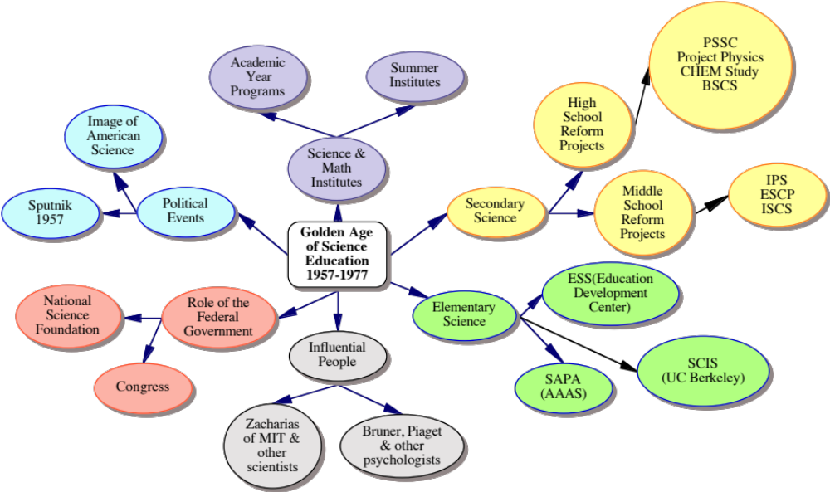
Golden Age Marker

